Slide 1
Prim’s Algorithm
Problem Definition: Implement Prim’s Algorithm to find minimum cost spanning tree of a given weighted connected Graph(G, V, E) and demonstrate its working.
CSE@GIT

Slide 2
Objectives of the Experiment:
To understand Graph and its Spanning Tree
2. To understand and appreciate the Greedy strategy
3. Present the working of Prim’s Algorithm
4. Learn to write Algorithm in standard form
5. Analyze the Algorithm for its time complexity

Slide 3
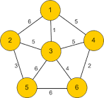
Graphs and their Properties
Wieght Connected Graph G( V, E )
G({n₁,n₂,n₃,…n_{n}}, {e₁},{e₂},{e₃}…………………{e_{n}} )
G ( {1,2,3,4,5,6}, {1,2},{1,4},{3,4},{{3,6}……..{5,6} )
Node
V – Node Vector
E -- Edge Vector
Cycles:.
1->2->3->1
1->4->3->1
4->3->6->4
5->6->4->3->5
1->2->5->6->4->1
Edge Weight
Edge

Slide 4
Minimum Spanning Tree
A spanning tree of an undirected graph G is a subgraph of G that is a tree containing all the vertices of G.
In a weighted graph, the weight of a subgraph is the sum of the weights of the edges in the subgraph.
A minimum spanning tree (MST) for a weighted undirected graph is a spanning tree with minimum weight.

Slide 5
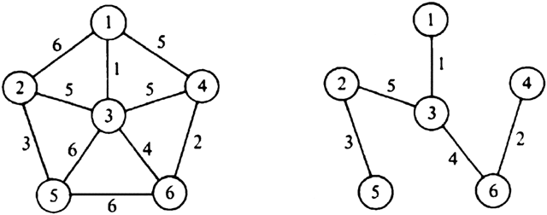
Graphs and its Spanning Tree
Graph G(V,E) Spanning Tree T(V,E)
Graph may or may not have loops
Tree will never have loops

Slide 6
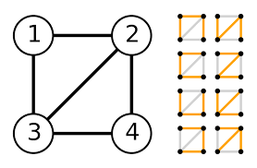
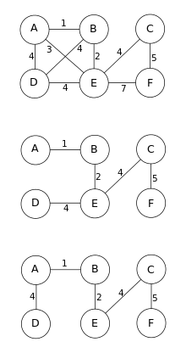
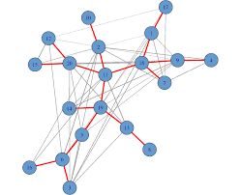
Graphs and its Spanning Tree More Examples…

Slide 7
Prim’s Algorithm – Greedy Approach
When we have a choice to make, make the one that looks best right now.
Make a locally optimal choice in hope of getting a globally optimal solution.
The choice that seems best at the moment is the one we go with.
Example :
Score highest in the first I.A. Test so as to maximize
average at the end of the semester

Slide 8

Greedy Choices
Maximize the Test Average
I.A. - 1
I.A. - 2
I.A. - 2
I.A. - 3
AVG
I.A. - 3
I.A. - 3

Slide 9
Typical Steps
Cast the optimization problem as one in which we make a choice and are left with one sub-problem to solve.
Prove that there’s always an optimal solution that makes the greedy choice, so that the greedy choice is always safe.
Make the greedy choice and solve top-down.
May have to preprocess input to put it into greedy order.

Slide 10
General MST(Min. Cost Spanning Tree)
Generic-MST(G, w)
//Input :G a weighted connected Graph, w – weight matix
// Output : A the min. cost spanning tree
Let A=EMPTY;
Start at any node in the Graph…
while A does not form a spanning tree
find an edge (u, v) that is safe for A, add (u, v) to A
return A
Doesn’t form a cycle

Slide 11
2
Update distances of adjacent, unselected nodes
F
3
C
 | Visited | U* | _{V*}
A
B
C |  | 3 | D
D | T | 0 | −
E |  | 25 | D
F |  | 18 | D
G |  | 2 | D
H
10
A
7
3
8
4
4
B
18
D
9
10
H
2
25
3
G
E
7

Slide 12
2
Select node with minimum distance
F
3
C
 | Visited | U* | _{V*}
A
B
C |  | 3 | D
D | T | 0 | −
E |  | 25 | D
F |  | 18 | D
G | T | 2 | D
H
10
A
7
3
8
4
4
B
18
D
9
10
H
2
25
3
G
E
7

Slide 13
2
Update distances of adjacent, unselected nodes
F
3
C
 | Visited | U* | _{V*}
A
B
C |  | 3 | D
D | T | 0 | −
E |  | 7 | G
F |  | 18 | D
G | T | 2 | D
H |  | 3 | G
10
A
7
3
8
4
4
B
18
D
9
10
H
2
25
3
G
E
7

Slide 14
2
Select node with minimum distance
F
3
C
 | Visited | U* | _{V*}
A
B
C | T | 3 | D
D | T | 0 | −
E |  | 7 | G
F |  | 18 | D
G | T | 2 | D
H |  | 3 | G
10
A
7
3
8
4
4
B
18
D
9
10
H
2
25
3
G
E
7

Slide 15
2
Update distances of adjacent, unselected nodes
F
3
C
 | Visited | U* | _{V*}
A
B |  | 4 | C
C | T | 3 | D
D | T | 0 | −
E |  | 7 | G
F |  | 3 | C
G | T | 2 | D
H |  | 3 | G
10
A
7
3
8
4
4
B
18
D
9
10
H
2
25
3
G
E
7

Slide 16
2
Select node with minimum distance
F
3
C
 | Visited | U* | _{V*}
A
B |  | 4 | C
C | T | 3 | D
D | T | 0 | −
E |  | 7 | G
F | T | 3 | C
G | T | 2 | D
H |  | 3 | G
10
A
7
3
8
4
4
B
18
D
9
10
H
2
25
3
G
E
7

Slide 17
2
Update distances of adjacent, unselected nodes
F
3
C
 | Visited | U* | _{V*}
A |  | 10 | F
B |  | 4 | C
C | T | 3 | D
D | T | 0 | −
E |  | 2 | F
F | T | 3 | C
G | T | 2 | D
H |  | 3 | G
10
A
7
3
8
4
4
B
18
D
9
10
H
2
25
3
G
E
7

Slide 18
2
Select node with minimum distance
F
3
C
 | Visited | U* | _{V*}
A |  | 10 | F
B |  | 4 | C
C | T | 3 | D
D | T | 0 | −
E | T | 2 | F
F | T | 3 | C
G | T | 2 | D
H |  | 3 | G
10
A
7
3
8
4
4
B
18
D
9
10
H
2
25
3
G
E
7

Slide 19
2
Update distances of adjacent, unselected nodes
F
3
C
 | Visited | U* | _{V*}
A |  | 10 | F
B |  | 4 | C
C | T | 3 | D
D | T | 0 | −
E | T | 2 | F
F | T | 3 | C
G | T | 2 | D
H |  | 3 | G
10
A
7
3
8
4
4
B
18
D
9
10
H
2
25
3
G
E
7
Table entries unchanged

Slide 20
2
Select node with minimum distance
F
3
C
 | Visited | U* | _{V*}
A |  | 10 | F
B |  | 4 | C
C | T | 3 | D
D | T | 0 | −
E | T | 2 | F
F | T | 3 | C
G | T | 2 | D
H | T | 3 | G
10
A
7
3
8
4
4
B
18
D
9
10
H
2
25
3
G
E
7

Slide 21
2
Update distances of adjacent, unselected nodes
F
3
C
 | Visited | U* | _{V*}
A |  | 4 | H
B |  | 4 | C
C | T | 3 | D
D | T | 0 | −
E | T | 2 | F
F | T | 3 | C
G | T | 2 | D
H | T | 3 | G
10
A
7
3
8
4
4
B
18
D
9
10
H
2
25
3
G
E
7

Slide 22
2
Select node with minimum distance
F
3
C
 | Visited | U* | _{V*}
A | T | 4 | H
B |  | 4 | C
C | T | 3 | D
D | T | 0 | −
E | T | 2 | F
F | T | 3 | C
G | T | 2 | D
H | T | 3 | G
10
A
7
3
8
4
4
B
18
D
9
10
H
2
25
3
G
E
7

Slide 23
2
Update distances of adjacent, unselected nodes
F
3
C
 | Visited | U* | _{V*}
A | T | 4 | H
B |  | 4 | C
C | T | 3 | D
D | T | 0 | −
E | T | 2 | F
F | T | 3 | C
G | T | 2 | D
H | T | 3 | G
10
A
7
3
8
4
4
B
18
D
9
10
H
2
25
3
G
E
7
Table entries unchanged

Slide 24
2
Select node with minimum distance
F
3
C
 | Visited | U* | _{V*}
A | T | 4 | H
B | T | 4 | C
C | T | 3 | D
D | T | 0 | −
E | T | 2 | F
F | T | 3 | C
G | T | 2 | D
H | T | 3 | G
10
A
7
3
8
4
4
B
18
D
9
10
H
2
25
3
G
E
7

Slide 25
2
Cost of Minimum Spanning Tree = Σ d_{v} = 21
F
3
C
 | Visited | U* | _{V*}
A | T | 4 | H
B | T | 4 | C
C | T | 3 | D
D | T | 0 | −
E | T | 2 | F
F | T | 3 | C
G | T | 2 | D
H | T | 3 | G
A
3
4
4
B
D
H
2
3
G
E
Done

Slide 26
Prim’s Algorithm
ALGORITHM Prim(G)
//Prim’s algorithm for constructing a minimum spanning tree //Input: A weighted connected graph G = V,E //Output: ET , the set of edges composing a minimum spanning tree of G
VT ← {v0} //the set of tree vertices can be initialized with any vertex
ET ← ∅
for i ← 1 to |V | − 1 do
find a minimum-weight edge e∗ = (v∗, u∗) among all the edges (v, u) such that v is in VT and u is in V − VT
VT ← VT ∪ {u∗}
ET ← ET ∪ {e∗}
return ET

Slide 27
Time and Space Complexity
Correctness can be proven by induction on the number of vertices
Applicable to both undirected and directed graphs
Efficiency
O(|V|²) for graphs represented by adj. matrix.
O(|E|log|V|) for graphs represented by adj. lists.

Slide 28
Learning Outcome of the Experiment and Conclusion
At the end of the session, students should be able to :
Explain the working of Greedy Strategy. [L2, CO 2, PO1]
Demonstrate the working of Prim’s algorithm on a given Graph G( V, w )
[L3, CO 2, PO3]
Test the algorithm for a number of test cases and verify. [L5, CO 2, PO3]
Analyze the algorithm’s time complexity [L4, CO 2, PO3]

